Slide 1

Analysis based on machine learning
<marketing case>
<Zhihui Chen>
<9/25/2022>

Slide 2

Agenda
Executive Summary
Problem Statement
EDA
Machine learning models
Conclusion

Slide 3
Executive Summary
ABC Bank wants to sell it's term deposit product to customers and before launching the product they want to develop a model which help them in understanding whether a particular customer will buy their product or not.
Our goal is to come out with insights based on EDA process and dive into different dimensions to figure out whom they need to pay special attention during marketing process, and a machine learning model to help them to make the marketing decision.

Slide 4
Problem Statement & Approach
Data Understanding
The dataset used for analysis is bank-full, covering 2 years from May, 2008 to Oct, 2010, and containing 45211 rows and 21 features.
10 numerical variables and 11 categorical variables are included in this dataset, in the following data processing session, the categorical variables needed to be processed to dummy variables.

Slide 5
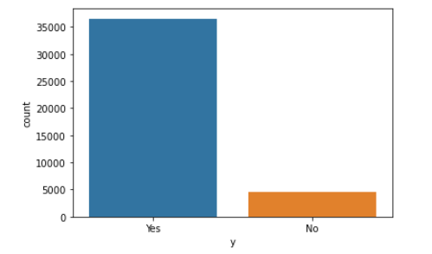
EDA
Data visualization (Initial dataset without cleaning and replacement)
Outcome
Outcome is the dependent variable (Y) in this dataset. The chart shows the y is imbalance, in further machine learning process we need to make up for the imbalanced part or delete some data with the outcome of ‘Yes’ randomly.

Slide 6
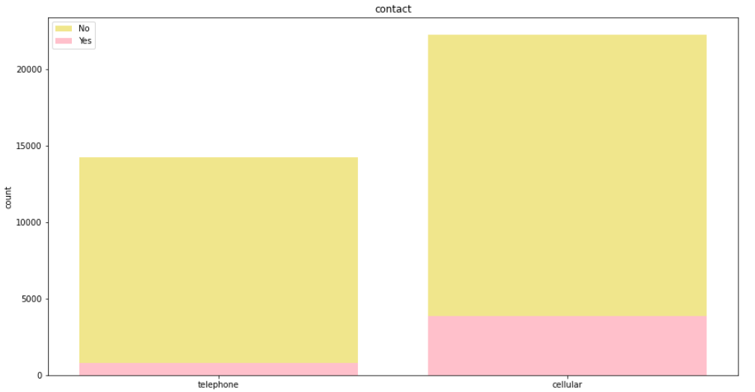
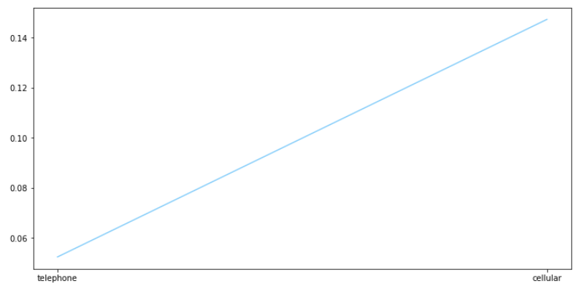
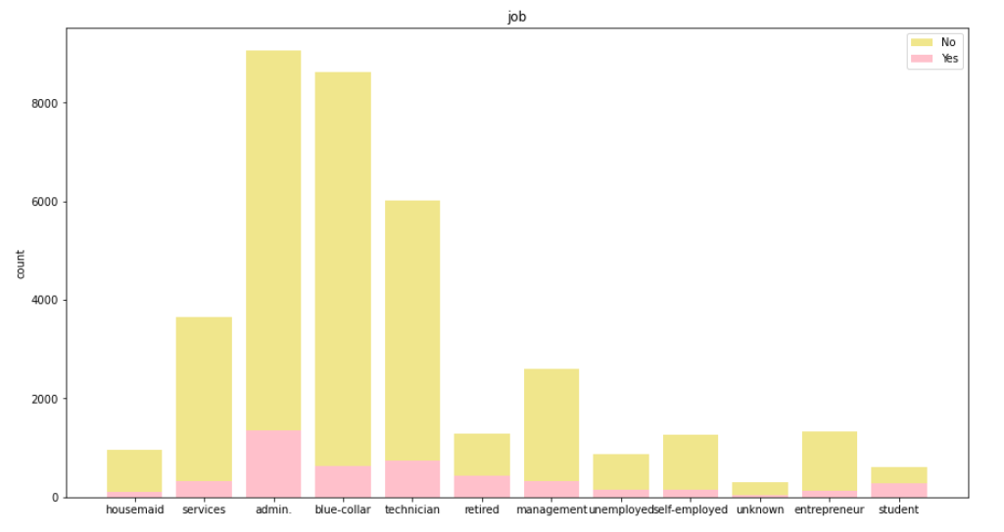
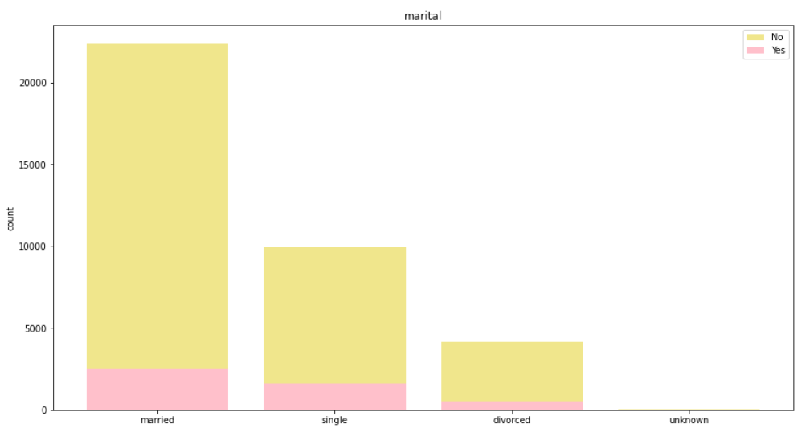
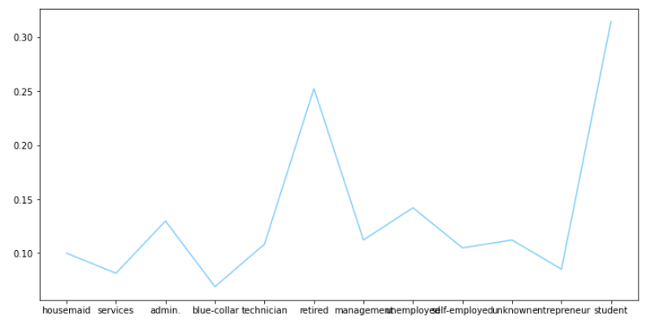
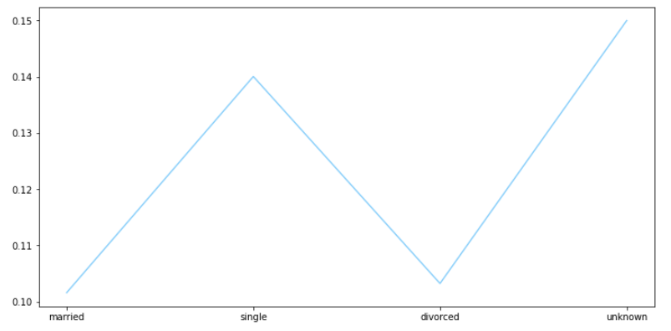
EDA
Data visualization (Initial dataset without cleaning and replacement)
Contact
Most clients prefer cellular phones as a contact method. By contacting people with their cellular contacts might be more possible to be answered.
Marital
Most clients are married.
Job
Majority of the clients are from admin. Category, meanwhile the rejection rate of admin. people are also higher than the other categories.

Slide 7
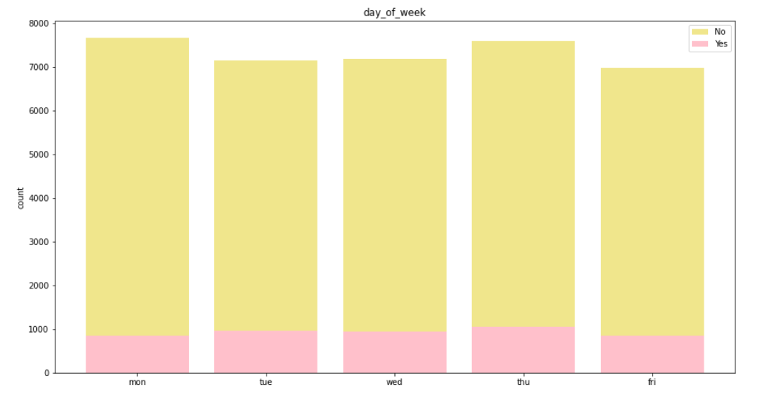
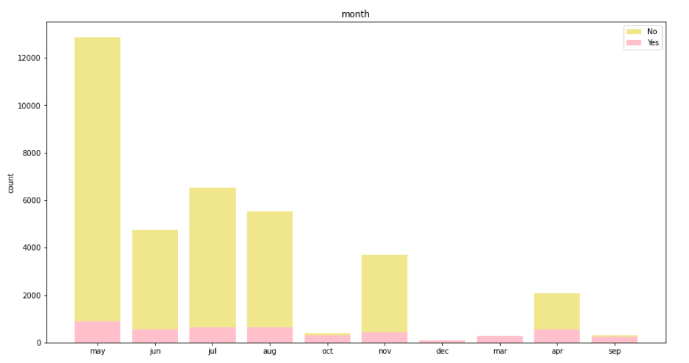
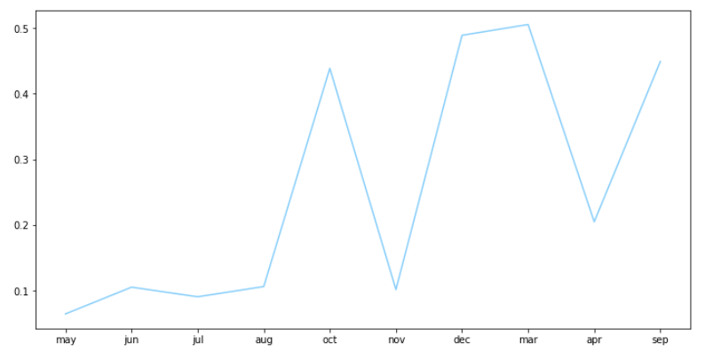
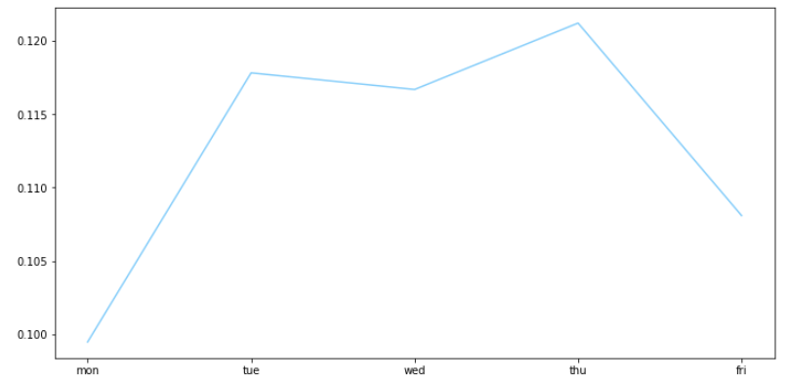
EDA
Data visualization (Initial dataset without cleaning and replacement)
Month
During summer, there are generally more phone calls, but the rejection rate are higher at the same time.
Day of week
This indicator has a uniform distribution, contact with clients in either of the days does not affect much on the rejection rate.

Slide 8
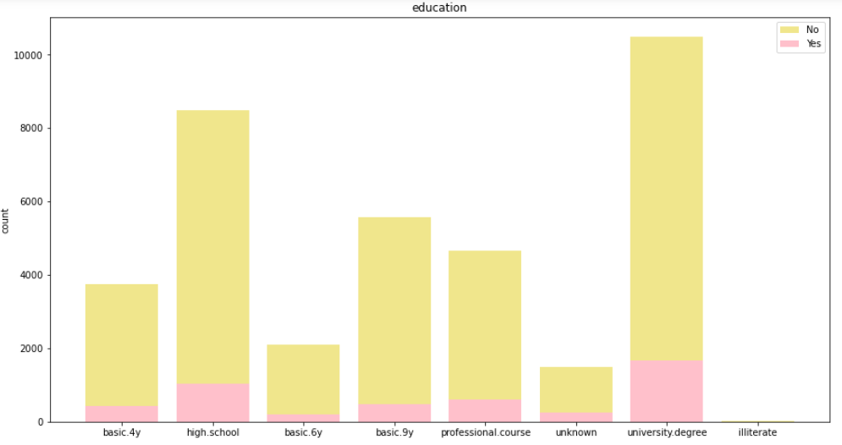
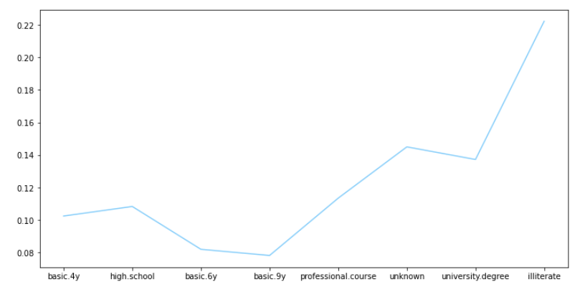
EDA
Data visualization (Initial dataset without cleaning and replacement)

Slide 9
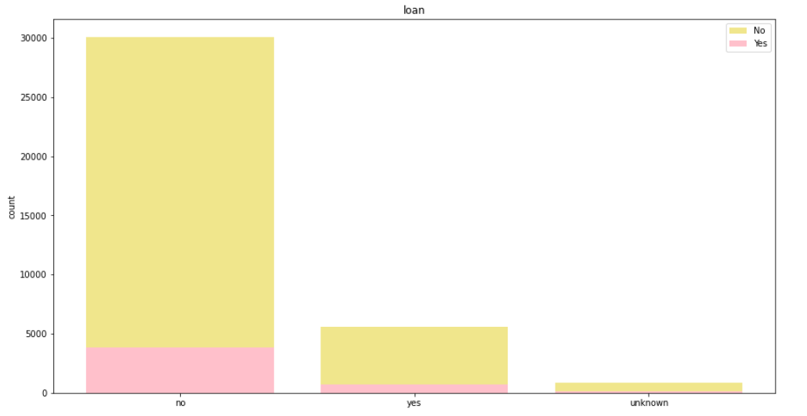
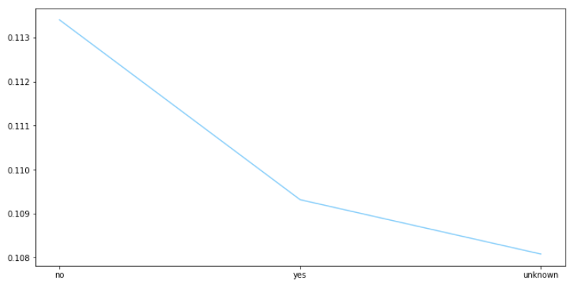
EDA
Data visualization (Initial dataset without cleaning and replacement)

Slide 10
EDA
Data visualization (Initial dataset without cleaning and replacement)

Slide 11
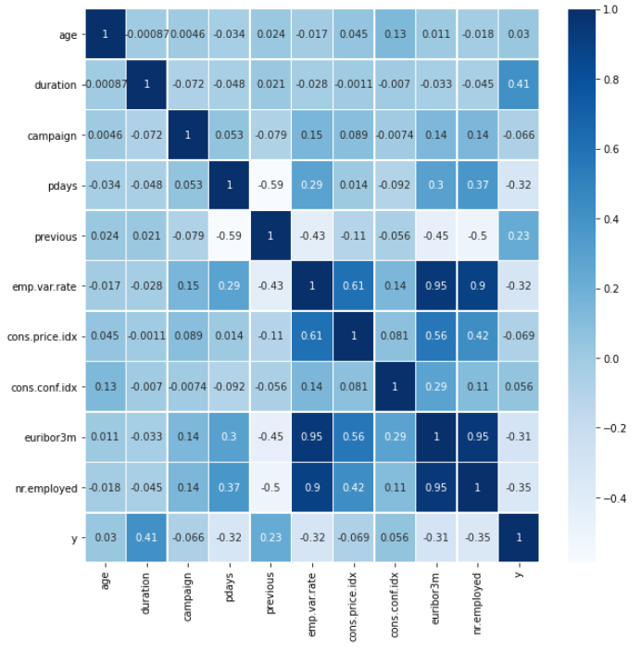
EDA
Data visualization (Initial dataset without cleaning and replacement)
The heatmap shows age, duration, number of contacts were made with a customer previously has obvious positive relationships with a ‘yes’ outcome.
While the number of days has passed since a customer was contacted last time, euribor 3 month rate, number of employments has negative relationship with a ‘Yes’ outcome

Slide 12
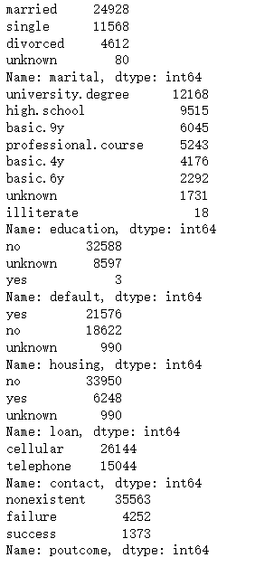
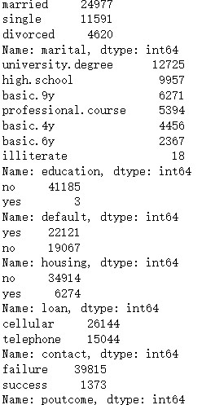
Data cleaning and Processing
Missing value replacement
Some of information are missing in the string variables, some of them are noted with ‘unknown’ or ‘nonexist’, though there are no obvious NaN values in this dataset, these ‘unknown’ variables will have impact to the model, as they are meaningless to the model training and selection process.
To handle these values, I used RandomForestClassifier to forecast the missing values. Since the int variables are all set, I used them as Xs in this missing value prediction model, and indicators 'marital', 'education', 'default', 'housing', 'loan', 'poutcome' as Y respectively.
The predicted values will replace the original ‘unknown’ and ‘nonexistence’ values.
Take marital as an example, its composition of each category is shown in the image below.

Slide 13
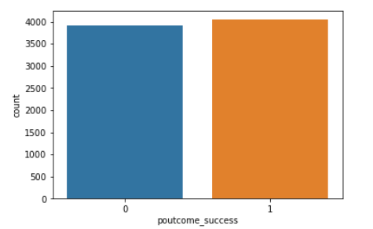
Data cleaning and Processing
Get dummy variables and balancing the outcome
Since some of the categories contain many features, dummy variables should be set up.
For the value in 'job', 'marital', 'education', 'default', 'housing', 'loan', 'contact', 'month', and 'poutcome', pd.get_dummies is used to generate the new dataset. Then the dataset contains 33 columns after taking dummy variables.
In the visualization part, we already know that the dataset is imbalance, two methods are used here to balance the dataset, undersample and oversample. Either method will give out the same pattern.

Slide 14
Data cleaning and Processing
PCA
After adding dummies to the model, independent variables in this case becomes 30. PCA helps to reduce the dimension of the features and can simplify the complexity of the model.

Slide 15
Model training
Model | Training score | Test score | Being selected or not
Logistic regression | 0.7790924313462827 | 0.7778804620793571 | NO
Ridge with grid search | 0.7115572672471535 | 0.7122852837769965 | NO
Decision Tree | 0.8559912926992633 | 0.8214665996986439 | NO
Random Forest | 0.8814434025452109 | 0.8499146157709694 | YES!
Linear SVC | 0.7783389149363699 | 0.7779407332998493 | NO
The test score indicates the accuracy of each model. Based on these results, Random Forest is the best model (with maximum depth equal to 10, maximum features equal to 4 and n estimators equal to 80).

Slide 16
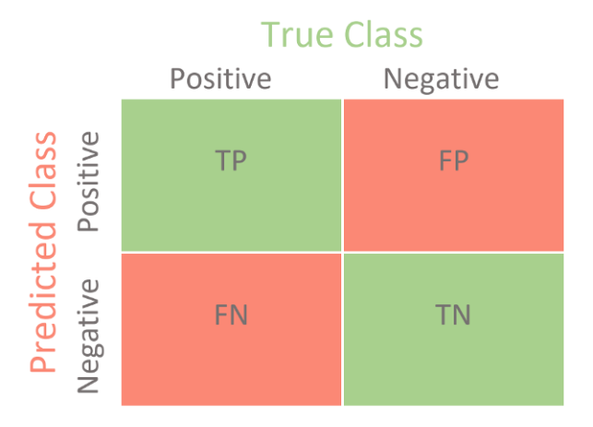
Model Training
Confusion matrix
Logistic Regression | 3558 | 361
 | 1390 | 2654
Ridge with grid search | 3919 | 0
 | 2294 | 1750
Decision Tree | 3060 | 859
 | 379 | 3665
Random Forest | 3566 | 353
 | 638 | 3406
Linear SVC | 3680 | 239
 | 1523 | 2521
Classification accuracy alone can be misleading if we have an unequal number. Calculating a confusion matrix can give a better idea of what the classification model is getting right and what types of error it is making.
The number of correct and incorrect predictions are summarized with count values and broken down by each class.
The confusion matrix shows the ways in which the classification model is confused when it makes predictions.

Slide 17
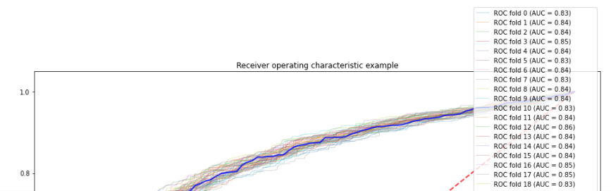
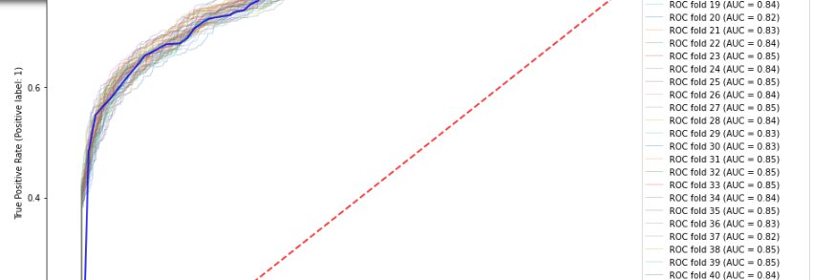
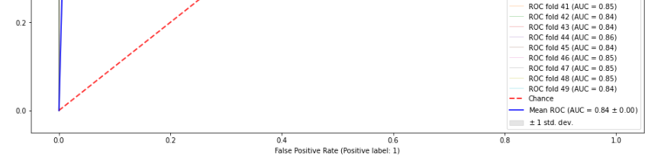
Model Training
ROC curve & AUC
Logistic regression
The ROC curve presents the false positive rate against the True positive rate.
AUC is the Graph under the ROC curve. It tells how much the model is capable of distinguishing between classes.
An excellent model would have AUC close to 1, from the charts, the models all looked good.

Slide 18
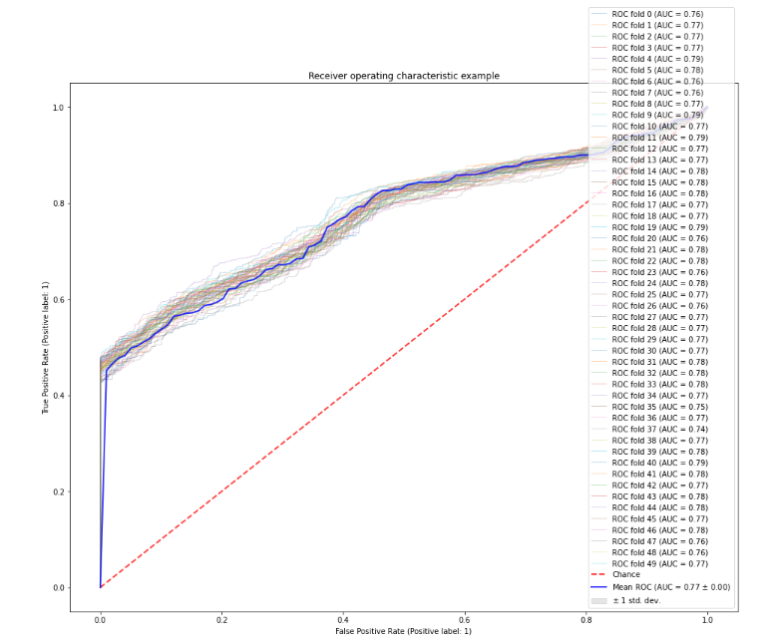
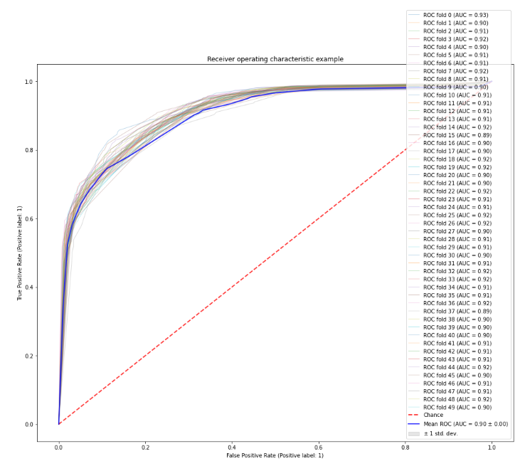
Model Training
ROC curve
Ridge with grid search
Decision Tree

Slide 19
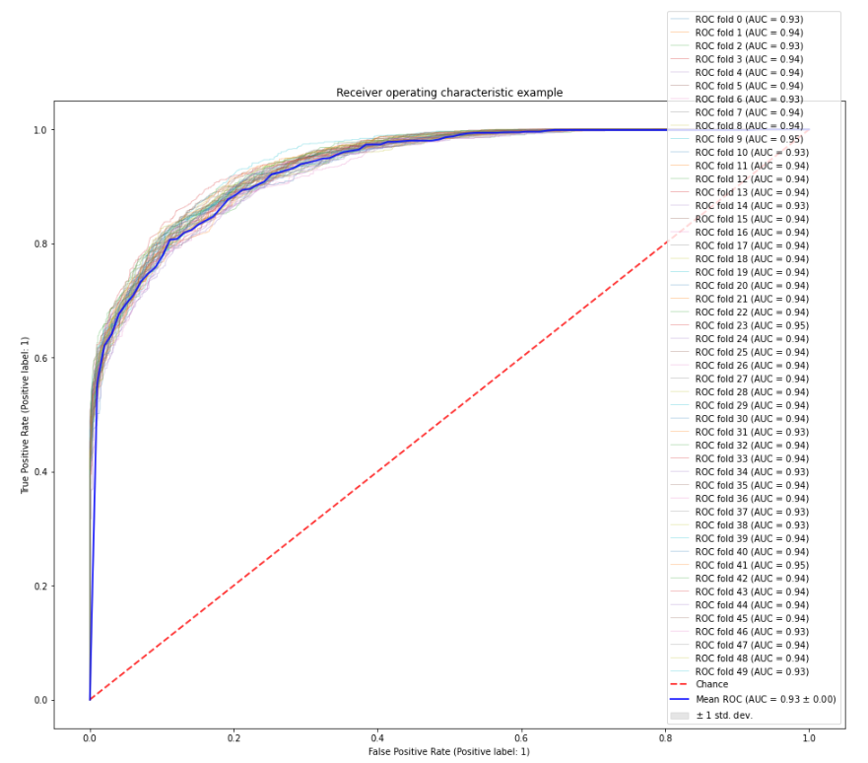
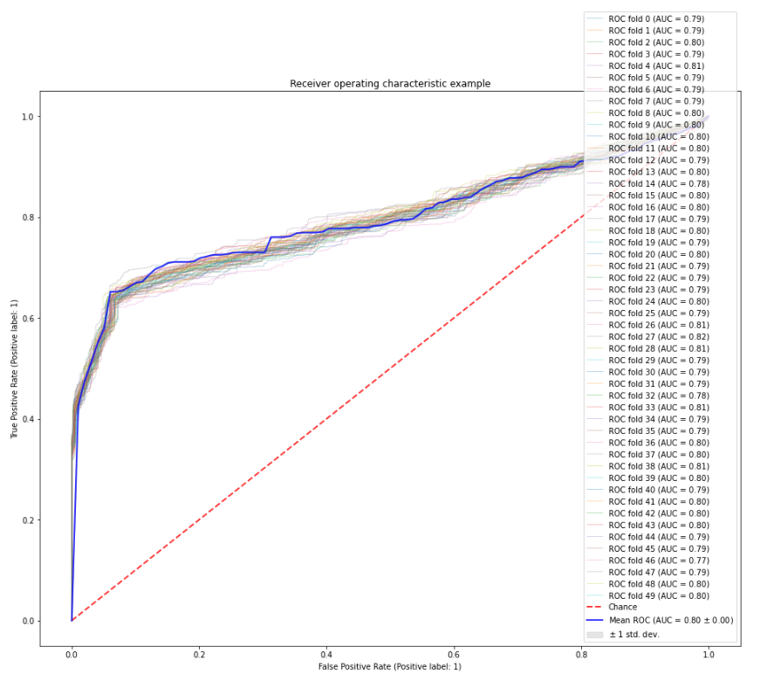
Model Training
ROC curve
Random Forest
Linear SVM
The AUC of all these models are not bad, however, random forest still beats the other models with an AUC of 0.93

Slide 20
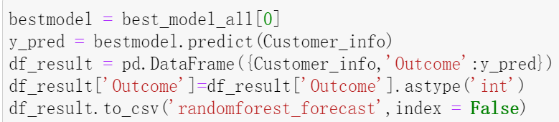
Model Selection
Based on the accuracy score, AUC, and confusion matrix, the final model is going to be used for forecasting is Random Forest Classifier with maximum depth equal to 10, maximum features equal to 4 and n estimators equal to 80.
If a new dataset of customer information is given, then the information could be used to replace the circled part in the following code. And a new file with the predicted outcome will be created automatically by the code.

Slide 21
Visualization insights and advice
Analysis on different categories of customers (categorical features)
Job: the top three occupation statues tend to have a positive result are student, retired and self-employed, and blue-collar people are the most likely to say NO
Marital: Single people are more likely to respond with YES
Education: Illiterate people tend to say YES, while people with primary, junior and senior school background tend to say NO
Housing: People have houses are more likely to say YES
Loan: People that not under loan are more likely to say YES
Phone: People are using cellular phones tend to respond with YES
Month: In March, December, September and October, people tend to accept the offer
Day of week: From Tuesday to Thursday are the high time people replying with YES
Customers that are student, retired and self-employed, single, illiterate and with education higher than high school, own a house and without loan, use cellular phones needs special attention
Better be called from Tuesday to Thursday during Sep, Oct, Dec

Slide 22
Visualization insights and advice
Analysis on different categories of customers (numerical features)
Duration: replying YES distribution looks like a normal distribution, the time better be controlled between 630s to 3600s.
Campaign: number of campaigns from 1 to 15 are more likely to have positive results
Pday: the less the better
Previous contacts: the number of times the customer was previously contacted and positive results are having positive relationships, previous contacts: the more the better

Slide 23
Conclusion
Final prediction model: Random Forest Classifier with maximum depth equal to 10, maximum features equal to 4 and n estimators equal to 80
Suggested special target customers:
Student, retired and self-employed
Single
Illiterate and people whos education level higher than high school
Own a house
Without loan
Use cellular phones
Reaching out time:
From Tuesday to Thursday
Sep, Oct, Dec
Frequency and other strategies:
Duration: from 600 to 3600
Campaign: from 1 to 15
Pdays: the less the better
Previous contacts: the more the better

